Slide 1



STATE HIGHER PROFESSIONAL EDUCATION
BELARUSIAN-RUSSIAN UNIVERSITY
DEPARTMENT
ELECTRIC DRIVE AND AUTOMATION
OF INDUSTRIAL INSTALLATIONS
INVESTMENT DESIGN INNOVATION IN THE ENERGY SYSTEM
course for undergraduates of the II stage of higher education specialty 1-43.80.01 "Electricity and Electrical Engineering" full-time and part-time studies
Mogilev
2020

Slide 2
INVESTMENT DESIGN INNOVATION IN THE ENERGY SYSTEM
Tutorial 6. EFFICIENCY OF REAL INVESTMENTS
Part 2.

Slide 3

INVESTMENT DESIGN INNOVATION IN THE ENERGY SYSTEM
Tutorial 6. EFFICIENCY OF REAL INVESTMENTS
Part 2.
6.6. Investment risks, their types and ways to reduce.
Risk models for investment projects
6.7. Non-economic project analysis

Slide 4
Tutorial 6.
Efficiency of real investments
Part 2.
INVESTMENT DESIGN INNOVATION IN THE ENERGY SYSTEM
6.6. Investment risks, their types and ways to reduce.
Risk models for investment projects
Investment risk is the risk of depreciation of the invested capital (loss of original value) as a result of ineffective actions of the company's management or the state. A smart Manager, when making up an investment portfolio, should first assess the risks of investing and only then look at the potential return. It is also true that high potential returns involve investment risk.

Slide 5

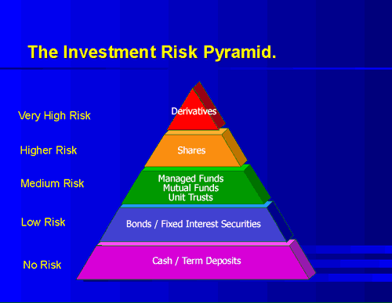
Tutorial 6.
Efficiency of real investments
Part 2.
INVESTMENT DESIGN INNOVATION IN THE ENERGY SYSTEM
In the most General case, investment risks can be represented in the form of a pyramid
Classification of investment risks:
1) by sources of occurrence
Systemic (also known as market, non-diversified) risk-is associated with external factors that affect the market as a whole. This is an integral part of any investment activity. This includes currency, inflation, political risks, and interest rate risk. This risk may be affected by changes in the stages of the economic cycle, changes in tax legislation, and the level of effective demand.
Non-market (non-system) risk implies industry, business, and credit risks. Such risks are inherent either in one investment instrument or in the activities of a particular investor. They can be reduced by creating an optimal investment portfolio (by diversifying risks), changing the investment strategy, and managing the object efficiently.

Slide 6
Tutorial 6.
Efficiency of real investments
Part 2.
INVESTMENT DESIGN INNOVATION IN THE ENERGY SYSTEM
Types of investment risks
Such a classification affects only the large group of risks, let us now consider in more detail each of the types:
Inflation risk – the risk caused by an increase in inflation - has a negative impact, since it reduces real profits. The real value of assets may decrease, despite the preservation or growth of its nominal value, the projected return on investment may not be achieved due to an uncontrolled increase in the rate of inflation that outstrips the return on investment. This risk is closely related to the risk of interest rate changes (interest rate risk).
Interest rate risk - risks arising from the possibility of changing the interest rate set by the Central Bank. Reducing the interest rate leads to a decrease in the cost of loans for businesses, which in turn leads to an increase in corporate profits and generally has a positive effect on the stock market
Currency risk –risk associated with possible changes in the exchange rate of one currency against another, primarily related to the economic and political situation in the country
Political risks – the risk of negative impact of political processes on economic
ones. Such risks should be understood as the possibility of a change of
government, war, revolution, etc.

Slide 7
Tutorial 6.
Efficiency of real investments
Part 2.
INVESTMENT DESIGN INNOVATION IN THE ENERGY SYSTEM
These risks are primarily market risks and cannot be controlled by the investor.
Non-systemic investment risks include:
1. Industry risk – the risk that all joint-stock companies in this industry are exposed to
2. Business risk – the risk associated with irrational management of the joint-stock company by the company's management and low production efficiency.
3. Credit investment risk arises when investments are made through borrowed funds and is expressed as the potential risk of the investor not to recover the loan funds in full due to changes in the value of his assets in the unpredictable side, lack of profitability or deterioration of these assets.
4. Country risk – the possibility of losses due to investment in objects under the jurisdiction of a country that does not have a strong economic and social situation
5. Risk of loss of profit - the possibility of indirect losses (losses or loss of profit) due to failure to perform a certain event

Slide 8
Tutorial 6.
Efficiency of real investments
Part 2.
INVESTMENT DESIGN INNOVATION IN THE ENERGY SYSTEM
6. Liquidity risk - the possibility of receiving losses due to the inability to quickly transfer assets to cash. Sometimes it is considered as a possibility of lack of funds to pay obligations to counterparties.
7. Selective investment risk - the probability of choosing a less profitable instrument in comparison with others.
8. Functional investment risk - the probability of receiving losses as a result of incorrect formation of the investment portfolio and its management
9. Operational investment risk - the possibility of receiving investment losses due to technical errors during operations, software failures, etc.

Slide 9
Tutorial 6.
Efficiency of real investments
Part 2.
INVESTMENT DESIGN INNOVATION IN THE ENERGY SYSTEM
Ways to reduce investment risks.
1. Regulation and control of the ratio of fixed and variable costs. By controlling this ratio, you can change the break-even point of a long-term investment and thereby directly affect the amount of project risk.
2. Price regulation. Pricing strategy for most enterprises is the most important way to manage the level of project and overall risk. Lowering the price increases potential demand, but also increases the break-even point. Investment sensitivity analysis, decision tree, and simulation are the main techniques for assessing the relationship between product price and risk.
3. Managing the amount of financial leverage. It is based on regulation and control of the ratio of own and borrowed sources of financing, as well as the feasibility of using funds that form fixed financial costs (loans, preferred shares, financial leasing). Raising additional borrowed funds generally increases the return on equity, but at the same time increases the risk of default in the event of an unfavorable set of circumstances for this investment project.

Slide 10
Tutorial 6.
Efficiency of real investments
Part 2.
INVESTMENT DESIGN INNOVATION IN THE ENERGY SYSTEM
4. Diversification of investment assets. By investing in different projects that are not affected by the same specific risk factors as much as possible, you can reduce the level of overall risk by eliminating its non-systematic component.
5. Careful consideration of the investment development strategy, taking into account the most favorable tax options, a preferred focus on preferential activities, and obtaining an investment tax credit contribute to an increase in gross income, greater predictability of cash flows, and overall reduction of project risk.
6. Regulation of the optimal volume of sales, monitoring production facilities, basing the level of demand balanced approach to the development of the project, and evaluate effective sales with regard to maximum utilization of production capacity and break-even level of sales.
7. Complex use of financial methods and levers for effective management of the investment program, improving the security of its implementation and reducing the overall risk of the enterprise, in particular, insurance, factoring (deferred payment) and the optimal combination of various forms of payment allow you to protect the enterprise from the
consequences of the insolvency of third-party organizations (suppliers, buyers
of products, banks, etc.).

Slide 11
Tutorial 6.
Efficiency of real investments
Part 2.
INVESTMENT DESIGN INNOVATION IN THE ENERGY SYSTEM
8. Flexible regulation of dividend payments and the development of an acceptable accounting policy for the company indirectly affect the level of overall risk by creating more favorable financial conditions for the implementation of the investment project.
9. Development of optimal investment policy values. Determining the maximum amount of borrowed capital and the safe term for non-repayment of receivables, the level of risk and industry profitability, setting the minimum size (share) of highly liquid assets and the maximum payback period for investments.
10. Creating a system of reserves in the enterprise. Formation of the reserve Fund, the Fund for repayment of bad accounts receivable, inventory, and the regulatory balance of cash and cash equivalents.
11. Detailed elaboration of the terms of capital construction contracts and other contracts, Including a list of force majeure circumstances, taking into account the possibility of revising the terms of delivery or sale of goods due to changes in external factors, providing for a system of penalties.
12. Reducing the negative consequences of current and future changes in the
project implementation conditions obtaining certain guarantees from
contractors, in the best case guarantees from third parties.

Slide 12
Tutorial 6.
Efficiency of real investments
Part 2.
INVESTMENT DESIGN INNOVATION IN THE ENERGY SYSTEM
In investment design, a distinction is made between a situation of uncertainty and a situation of risk. In a situation of uncertainty, it is difficult or even impossible to determine the probability of obtaining the expected results from an investment project. The risk is considered as a derivative situation of uncertainty and is characterized by the fact that the probability of achieving the expected project parameters is determined and taken into account in the corresponding calculations.
In particular, as a starting point, the condition is accepted that the investment costs distributed over time and the results of their implementation are not exactly known. Therefore, in practice, a certain multiplicity of their meanings and the "degree of possibility" of each of them manifesting in real circumstances are taken into account. This situation requires special calculations that allow for instability of project costs and results, as well as possible variation in effect values.
The most appropriate economic practice is recognized as calculations reflected through the construction of risk and profitability models of the project and their comparative assessment.
In General, for calculations, the risk of an investment project is determined by
the probability of deviation of the real cash flow from its expected values.
Most often, the following models are used for risk assessment.

Slide 13
Tutorial 6.
Efficiency of real investments
Part 2.
INVESTMENT DESIGN INNOVATION IN THE ENERGY SYSTEM
Simulation model for risk assessment.
The model is based on the expert assessment method, which involves choosing one of the possible cash flow options associated with an investment project:
- Worst (pessimistic);
- Real;
- Best (optimistic).
1. for each of these options, its own indicators of the net discounted flow (DNCF) are calculated
2. Range of variation that reflects the largest change in the DNCF
3. Average square deviation of the DNCF (σ_{DNCF} ) according to the follow formula.
DNCF_{i} – net discounted flow of each of the considered
options (worst, real, and best)
– average value weighted by the assigned probabilities for each option (P_{i}), i.e.

Slide 14
Tutorial 6.
Efficiency of real investments
Part 2.
INVESTMENT DESIGN INNOVATION IN THE ENERGY SYSTEM
In General, if investment in a project is considered capital outflow, then DNCF can be considered as NPV.
Remind:

Slide 15
Tutorial 6.
Efficiency of real investments
Part 2.
INVESTMENT DESIGN INNOVATION IN THE ENERGY SYSTEM
Model of probable changes in cash flow. The model is based on the method of expert assessment of the probability of the annual cash flow, which serves as a reference point for adjusting previously calculated values of the DNCF. Risk assessment is carried out in accordance with the adjusted value of the DNCF. In other words, out of the two investment projects, the one with the lower adjusted DNCF value is considered to be the most risky.
Sensitivity model of the project. The model is based on the fact that in the course of its construction, a single change in all "risk-tested" interrelated indicators is carried out sequentially. If one of the values changes by the predicted value, all related project parameters must be recalculated.

Slide 16
Tutorial 6.
Efficiency of real investments
Part 2.
INVESTMENT DESIGN INNOVATION IN THE ENERGY SYSTEM
In international practice, the method of constructing a model based on calculating the break-even point is widely used. It involves studying the relationship between production volume, cost and profit when these indicators change during the project implementation process. Therefore, the break-even analysis is considered as a simulation of a real process and is based on the following provisions:
1. Invariability of selling prices for consumed resources throughout the project implementation period;
2. Division of costs based on their reactivity to changes in production volume into variables and constants;
3. Compliance with the proportionality between sales made and revenue received;
4. Maintaining a constant product range and assortment and equality of production and sales.

Slide 17
Tutorial 6.
Efficiency of real investments
Part 2.
INVESTMENT DESIGN INNOVATION IN THE ENERGY SYSTEM
Capital asset valuation model.
The model is based on the beta coefficient method, which is used to calculate the discount rate.
Formalized the model is presented in the literature as follows:
R – Rate of return required by the investor (on equity);
R_{f} – Risk-free income rate;
β – Beta coefficient;
R_{т} – Total or average return in the industry (business, market).
In world practice, the risk-free rate of income is the rate of income that is guaranteed by the state, for example, for long-term government obligations.
The total or average return is determined by a certain number of the most significant entities present in the industry (business, market).
β-coefficient defines a measure of risk, which is calculated using the following methods: analysis of P-coefficients of similar enterprises or previously implemented investment projects; weighted average cost of capital.
In the first case, an essential requirement for calculating the β-coefficient is the correctness
of the choice of an analog and the formation of a basic scenario for the proposed investment
project based on it. At the same time, the understanding of the term "risk" is somewhat
changed - it includes any deviations (positive or negative) of the project's profitability from
the originally set values.

Slide 18
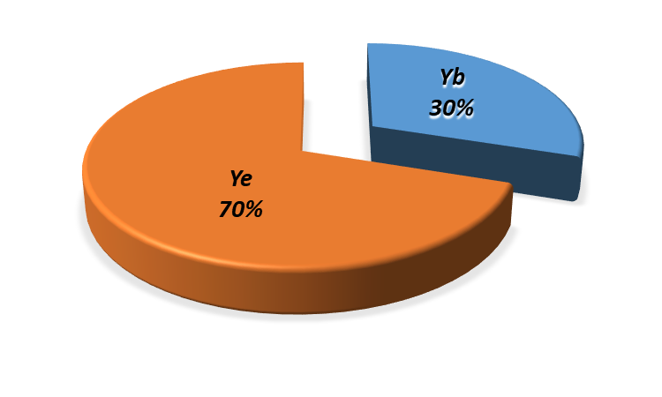
Tutorial 6.
Efficiency of real investments
Part 2.
INVESTMENT DESIGN INNOVATION IN THE ENERGY SYSTEM
The weighted average cost of capital method requires taking into account the structure of resources attracted for project financing, both own and borrowed. The discount rate (Rd) in this case is calculated as the weighted average value of the cost of equity and debt capital (WACC), taking into account their share in the total capital of the project:
R_{e} – Cost (price) of equity;
R_{b} – Cost (price) of borrowed capital;
Y_{e} и Y_{b} – Shares of equity and borrowed (debt) capital in the total capital of the project, respectively.
However, despite the obvious simplicity of this method, it has a number of disadvantages. In particular, it was originally based on the financing structure may change in the process of project implementation, often for reasons beyond the control of the company. Also, the price of equity and debt capital, determined for the projected (estimated) period of project implementation, is very rarely stable.
Thus, each of the considered models is focused on its own field of application, but all of them are somehow based on probabilistic estimates and taking into account the possibility of various combinations of external conditions for the implementation of an investment project.

Slide 19
Tutorial 6.
Efficiency of real investments
Part 2.
INVESTMENT DESIGN INNOVATION IN THE ENERGY SYSTEM
6.7. Non-economic project analysis
Commons. The term "non-economic" is formal because any aspect of the analysis somehow affects financial and economic issues.
Non-economic methods of project analysis include:
• Technical analysis;
• Social analysis;
• Environmental analysis;
• Institutional and organizational analysis.

Slide 20
Tutorial 6.
Efficiency of real investments
Part 2.
INVESTMENT DESIGN INNOVATION IN THE ENERGY SYSTEM
Technical analysis of the project.
The main purpose of the technical analysis is to justify the technological and technical feasibility of the project - the availability of technologies and equipment necessary for the production of project products, the possibility of their development and effective operation in specific conditions.
Technical analysis is usually presented at the beginning of project documents.
In the course of its implementation, technical and technological alternatives, options for the location of the enterprise, project implementation dates, technological availability of raw materials, etc. are studied.
Technical analysis is carried out throughout the project life cycle, taking into account the General tasks that are solved at each of its stages.
Sequence and content of technical analysis of the project

Slide 21
Tutorial 6.
Efficiency of real investments
Part 2.
INVESTMENT DESIGN INNOVATION IN THE ENERGY SYSTEM
The analyzed factor | Composition of the analyzed factor
1. Location of the enterprise and auxiliary production facilities | 1.1. Availability of sources of raw materials, energy, water, communication facilities, proximity to markets for products 1.2. Degree of development of the district's infrastructure (availability of transport highways, social facilities, etc.) 1.3. Availability of the district's (non -) qualified and labor force, managerial personnel
2. Scope and timing of project implementation | 2.1. The scale of the project (production of the item) 2.2. The length of a project
3. Technological processes | 3.1. Used technological processes 3.2. Compliance of equipment with production conditions and district characteristics 3.3. Possibilities of reconstruction and modernization of existing enterprises 3.4. Options for purchasing equipment from domestic and foreign manufacturers (suppliers), as well as leasing)
4. Development of project options | 4.1. Preliminary versions of the project 4.2. The results of expert assessment of technical means and technologies provided by the project

Slide 22
Tutorial 6.
Efficiency of real investments
Part 2.
INVESTMENT DESIGN INNOVATION IN THE ENERGY SYSTEM
The analyzed factor | Composition of the analyzed factor
5. Project diagram | 5.1. Layout of main and spare production facilities 5.2. The scheme of placing of objects of industrial and social infrastructure 5.3. Organization of transportation of products 5.4 Organization of communication system 5.5. The possibility of expansion of the company
6. Estimates | 6.1. The cost estimates for the purchase and delivery of equipment 6.2. Estimates of PA and construction work 6.3. The cost estimates for the purchase of materials, fuel and other current assets 6.4. Cost estimates for training
7. The project implementation schedule | 7.1. Organization of the process of placing orders and entering into contracts with producers or suppliers of resources 7.2. Calendar plan for the construction phase of the project 7.3. Calendar plan of the preparatory period, including schedules of equipment receipt and installation, as well as schedules of working capital formation

Slide 23
Tutorial 6.
Efficiency of real investments
Part 2.
INVESTMENT DESIGN INNOVATION IN THE ENERGY SYSTEM
Social analysis of the project. The task of social analysis is to determine the suitability of the proposed project options from the point of view of the interests of the population of the territory that it affects with its products. A special requirement is to consider and take into account the interests of the population groups that are most sensitive to changes made by the project.
As a result, of the social analysis, the project outlines a strategy for its implementation that would ideally benefit from the support of the local population and the social group that it affects. In addition, the project should be accepted (or at least "overlooked") by the public, especially for environmental reasons.
Social analysis should be carried out in conjunction with other types of project analysis. A number of questions are expected to be answered as a result of social analysis.
• Is the project socially and culturally acceptable in the local context?
• What are the positive and negative social and cultural impacts of the project?
• What are the quantitative estimates of the costs and benefits associated
with these effects?

Slide 24
Tutorial 6.
Efficiency of real investments
Part 2.
INVESTMENT DESIGN INNOVATION IN THE ENERGY SYSTEM
When conducting social analysis, the following groups of social indicators can be used:
Demographics,
Employment indicator,
Social structure (educational structure, professional structure).
Public life,
Housing, health, security, transport.
The social impact assessment of the project should be accompanied by an economic assessment to minimize its possible negative impacts on various social groups.
However, the implementation of any project (and even more so related to the development of energy sources) causes a certain change in the situation in the political, economic or social spheres. This change may be beneficial to some social groups; unprofitable (or even harmful) to others. In this regard, the final expert opinion should take into account the
interests of not only individual social groups, but also society as a whole.

Slide 25
Tutorial 6.
Efficiency of real investments
Part 2.
INVESTMENT DESIGN INNOVATION IN THE ENERGY SYSTEM
Environmental analysis of the project.
The task of environmental project management is to establish a balance between people's need for natural resources and the ability of the environment to meet these needs.
For environmental protection measures, preventive measures are much more important and almost always cheaper than correcting the damage.
The cost of modifying the project in order to bring it in line with the current environmental criteria should be considered as necessary. To improve the project's effectiveness, environmental issues should be reflected in the project document at the earliest stage. This documentation should justify the environmental risks and the possibilities of reducing them through an appropriate action plan.
Conducting a standard analysis of the environmental performance of projects is often difficult due to the fact that environmental costs and benefits are detected over a relatively long time, and they are quite difficult to measure and predict.

Slide 26
Tutorial 6.
Efficiency of real investments
Part 2.
INVESTMENT DESIGN INNOVATION IN THE ENERGY SYSTEM
If the scale and type of environmental changes can be predicted, the existing system of markets and prices can provide a more or less unambiguous estimate of the monetary value of some of the consequences of these changes. It is much more difficult to assess the effects of such pollution on human health. The cost of some consequences can be determined using statistics from health authorities by calculating the cost of forced relocation of people, etc.
If the costs and benefits cannot be quantified, the consequences of alternative solutions should be evaluated qualitatively. Qualitative analysis, as well as quantitative analysis, should show the difference between "with a project" and "without a project" situations, as well as the difference between alternative options.

Slide 27
Tutorial 6.
Efficiency of real investments
Part 2.
INVESTMENT DESIGN INNOVATION IN THE ENERGY SYSTEM
Institutional and organizational analysis.
Institutional-organizational or simply institutional analysis of investment projects aims to assess the organizational, legal, political and administrative environment in which projects are implemented and operated.
A number of questions are expected to be answered as a result of the institutional analysis.
• Are the appropriate organizational structures and legal environment in place to implement the project?
• Is the infrastructure necessary for the implementation and operation of the project available?
• What is the probability of the project being implemented within the specified time frame and what are the risks associated with the project?

Slide 28
Tutorial 6.
Efficiency of real investments
Part 2.
INVESTMENT DESIGN INNOVATION IN THE ENERGY SYSTEM
The active form of developing recommendations for measures to strengthen the capabilities of organizations (recipient enterprises) implementing the project involves consideration of:
• Methods and methods of production management;
• Organizational structure, possible changes in it;
• Planning, including investment planning;
• Recruitment and training issues;
• Financial activities, including financial management, accounting and auditing;
• Material and technical support of projects.

Slide 29
Tutorial 6.
Efficiency of real investments
Part 2.
INVESTMENT DESIGN INNOVATION IN THE ENERGY SYSTEM
Two aspects of project management should be highlighted:
• Methods of work coordination;
• Activities to improve project management.
One way to overcome the organizational problems inherent in fairly large projects is to simplify them by identifying activities that are essential for achieving the main goal of the project, and focusing on them limited organizational resources at the cost of assigning desirable, but difficult or secondary tasks for the future.
A similar approach should be applied to the requirements for coordinating the work of various project performers, since it may take a long time, but it may not produce the expected results. In addition, a system should be established to encourage interaction between project employees and organizations implementing the project. Creating, for example, small working groups of those who control non-primary but important resources (for example, vehicles) may be a more productive coordination mechanism than creating, for example, a coordinating Committee consisting of senior staff.
Institutional problems in the operational phase of a project are often related to the fact that decision makers focus more on the capital investment phase than on the subsequent operation and maintenance phases of the completed project. One aspect of neglecting the operation of
the project is that too little attention is paid to the costs and benefits associated with
maintenance, maintenance, reconstruction or improvement of fixed assets, and
consequently, the reduction of project benefits.

Slide 30
Tutorial 6.
Efficiency of real investments
Part 2.
INVESTMENT DESIGN INNOVATION IN THE ENERGY SYSTEM
Two aspects of project management should be highlighted:
• Methods of work coordination;
• Activities to improve project management.
One way to overcome the organizational problems inherent in fairly large projects is to simplify them by identifying activities that are essential for achieving the main goal of the project, and focusing on them limited organizational resources at the cost of assigning desirable, but difficult or secondary tasks for the future.
A similar approach should be applied to the requirements for coordinating the work of various project performers, since it may take a long time, but it may not produce the expected results. In addition, a system should be established to encourage interaction between project employees and organizations implementing the project. Creating, for example, small working groups of those who control non-primary but important resources (for example, vehicles) may be a more productive coordination mechanism than creating, for example, a coordinating Committee consisting of senior staff.
Institutional problems in the operational phase of a project are often related to the fact that decision makers focus more on the capital investment phase than on the subsequent operation and maintenance phases of the completed project. One aspect of neglecting the operation of
the project is that too little attention is paid to the costs and benefits associated with
maintenance, maintenance, reconstruction or improvement of fixed assets, and
consequently, the reduction of project benefits.

Slide 31
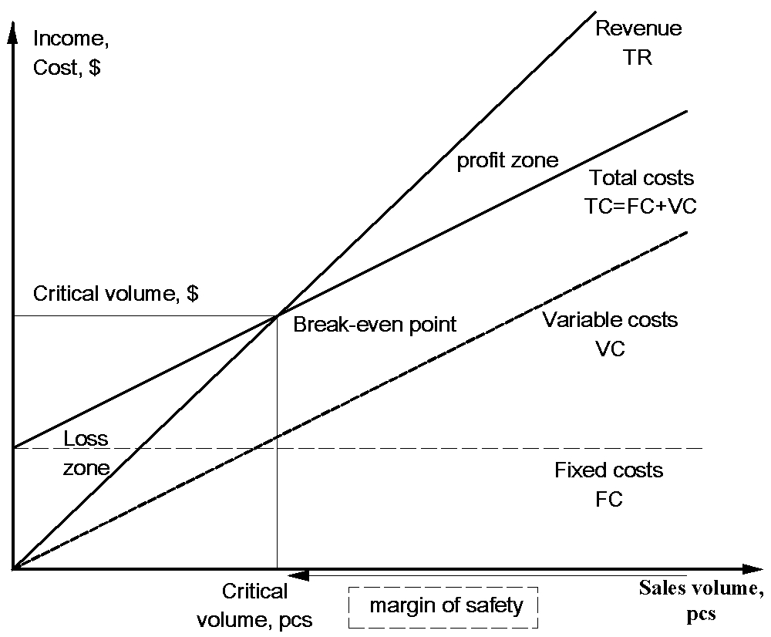
Tutorial 6.
Efficiency of real investments
Part 2.
INVESTMENT DESIGN INNOVATION IN THE ENERGY SYSTEM
Reference
Break-even point (critical point, CVP-point) – the volume of production and sales of products, at which expenses will be compensated by income, and during the production and sale of each subsequent unit of production, the enterprise begins to make a profit. The break-even point can be defined in units of output, in monetary terms, or based on the expected profit margin.
Not to be confused with the payback point (project). It is calculated to determine the time when the revenue from the project will exceed the costs spent on it. this is the same break-even point, only it is measured in
months and years, not in units.
Picture 1. - Break-even point

Slide 32
Tutorial 6.
Efficiency of real investments
Part 2.
INVESTMENT DESIGN INNOVATION IN THE ENERGY SYSTEM
Test
Classification of investment risks
Types of investment risks
Ways to reduce investment risks.
Simulation model for risk assessment
Capital asset valuation model.
The weighted average cost of capital method
Non-economic methods of project analysis
Break-even point

